Slide 1
A Place For His Dwelling

Slide 2
^{“18}Flee sexual immorality. Every sin that a man does is outside the body, but he who commits sexual immorality sins against his own body. ¹⁹Or do you not know that your body is the temple of the Holy Spirit who is in you, whom you have from God, and you are not your own? ²⁰For you were bought at a price; therefore glorify God in your body and in your spirit, which are God’s.” (1 Corinthians 6:18-20)
I Will Be Pure
“¹⁶And what agreement has the temple of God with idols? For you are the temple of the living God. As God has said: “I will dwell in them And walk among them. I will be their God, And they shall be My people.” ¹⁷Therefore “Come out from among them And be separate, says the Lord. Do not touch what is unclean, And I will receive you. …
… ¹⁸“I will be a Father to you, And you shall be My sons and daughters, Says the Lord Almighty.” ¹Therefore, having these promises, beloved, let us cleanse ourselves from all filthiness of the flesh and spirit, perfecting holiness in the fear of God.” (2 Corinthians 6:16-7:1)

Slide 3
I Will Build with You
“The whole building, being fitted together, grows into a holy temple in the Lord, ²²in whom you also are being built together for a dwelling place of God in the Spirit.” (Ephesians 2:21-22)
^{“16}Do you not know that you are the temple of God and that the Spirit of God dwells in you? ¹⁷If anyone destroys the temple of God, God will destroy him. For the temple of God is holy, which temple you are.” (1 Cor. 3:16-17)

Slide 4
I Will Listen to the Lord
we have “been built on the foundation of the apostles and prophets, Jesus Christ Himself being the chief cornerstone,” (Ephesians 2:20)

Slide 5
I Will Joyfully Work
“The people are bringing more than enough for doing the work the LORD commanded to be done” (Exodus 36:5)
“As living stones, are being built up a spiritual house, a holy priesthood, to offer up spiritual sacrifices acceptable to God through Jesus Christ.” (1 Peter 2:5)

Slide 6
I Will Expectantly Wait
“He who overcomes, I will make him a pillar in the temple of My God, and he shall go out no more.” (Revelation 3:12)
“before the throne of God, and serve Him day and night in His temple. And He who sits on the throne will dwell among them.” (Revelation 7:15)
“I saw no temple in it, for the Lord God Almighty and the Lamb are its temple.” (Revelation 21:22)

Slide 7
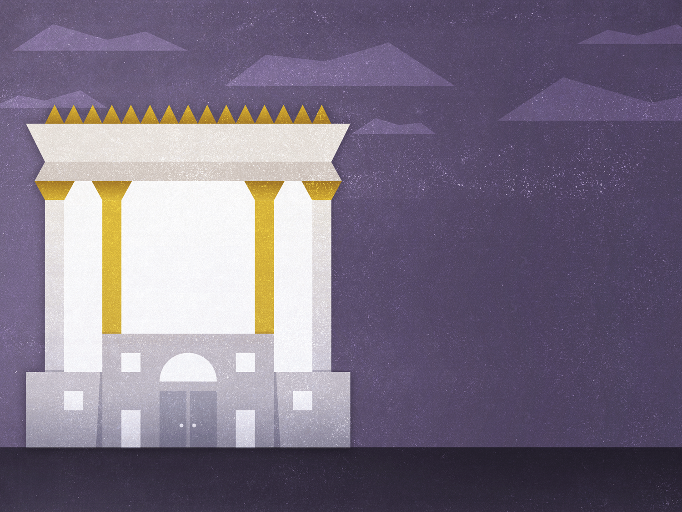
Do Others See…
Him
…in you?

